Slide 1
My favorite dish

Slide 2
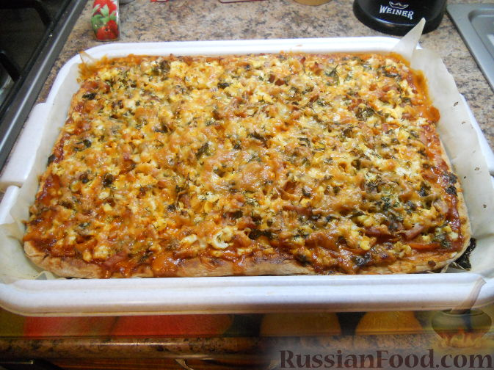
My favorite dish
I like homemade pizza from mom

Slide 3
My favorite dish
Why do I like this dish?
I like homemade pizza from mom

Slide 4
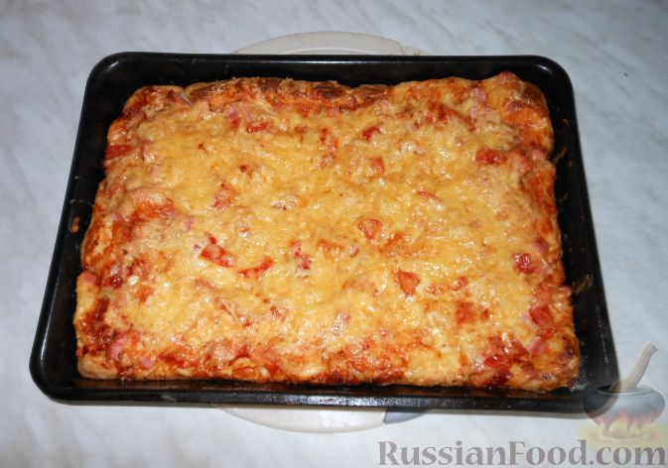
Why do I like this dish?
how to cook a pizza?
I like homemade pizza from mom

Slide 5
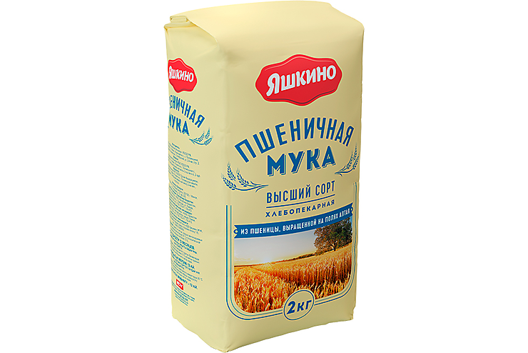
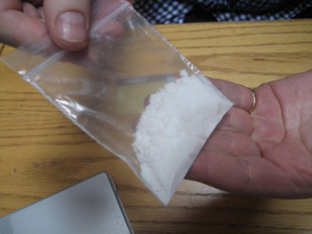
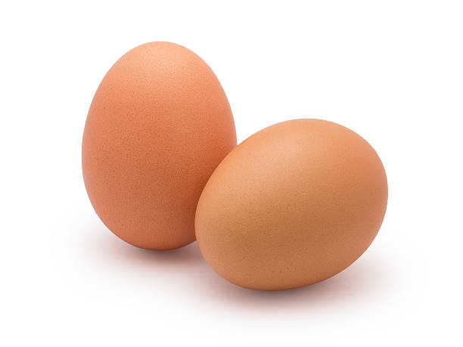
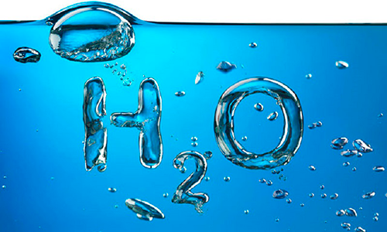
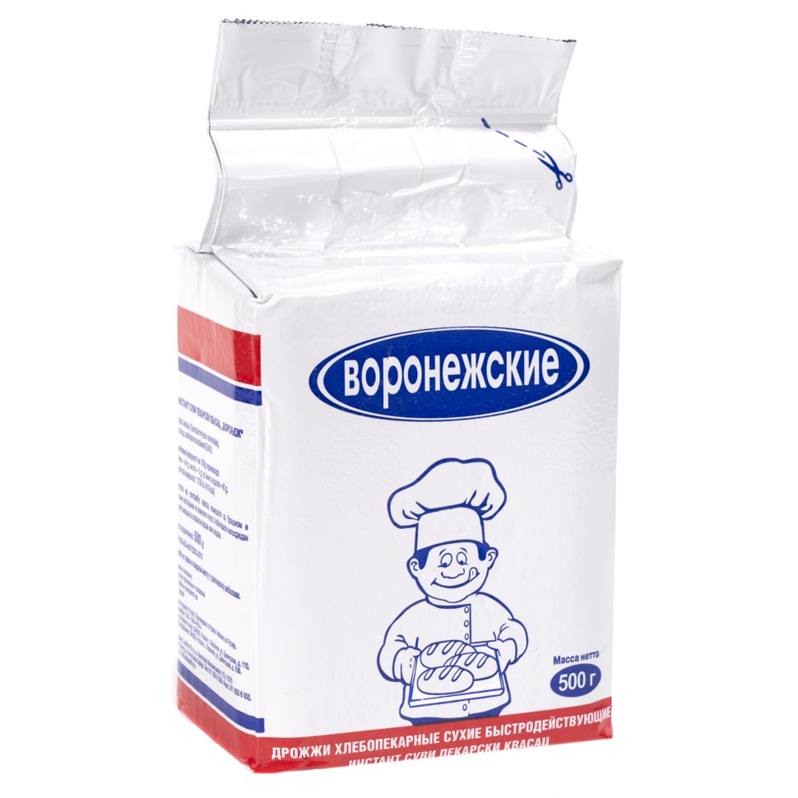
Why do I like this dish?
ingredients for the dough
how to cook a pizza?

Slide 6
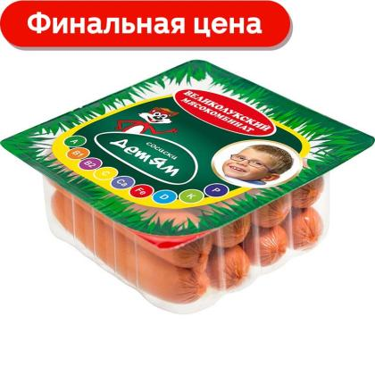
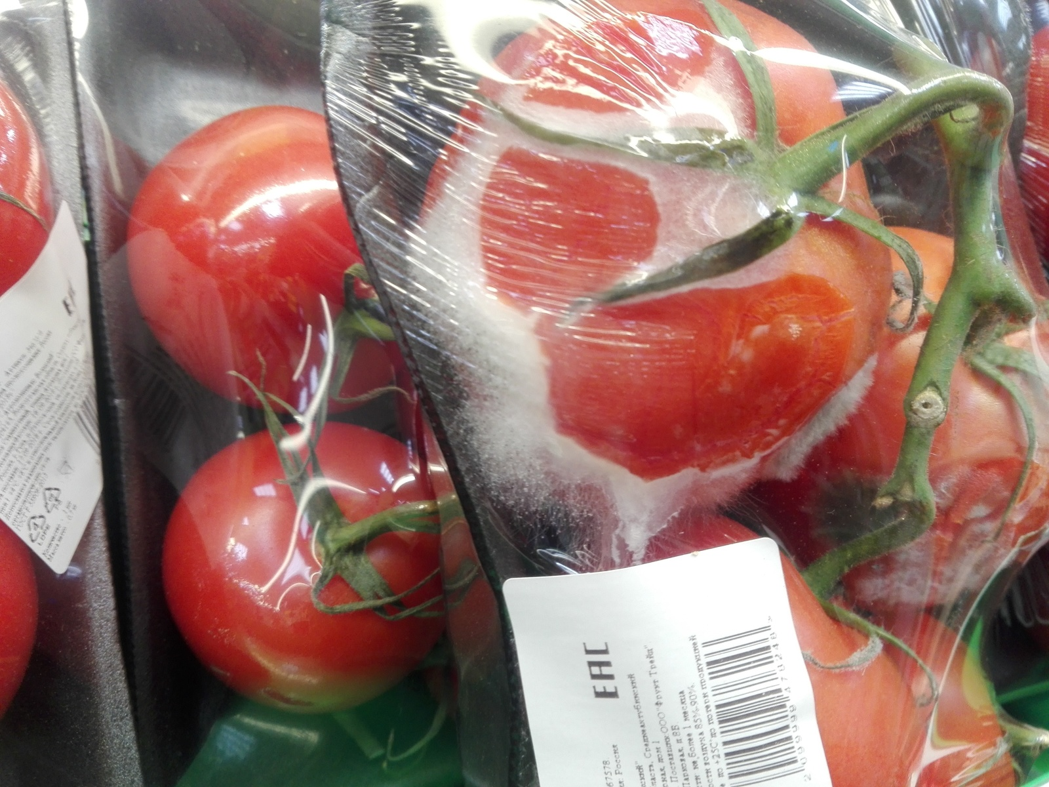
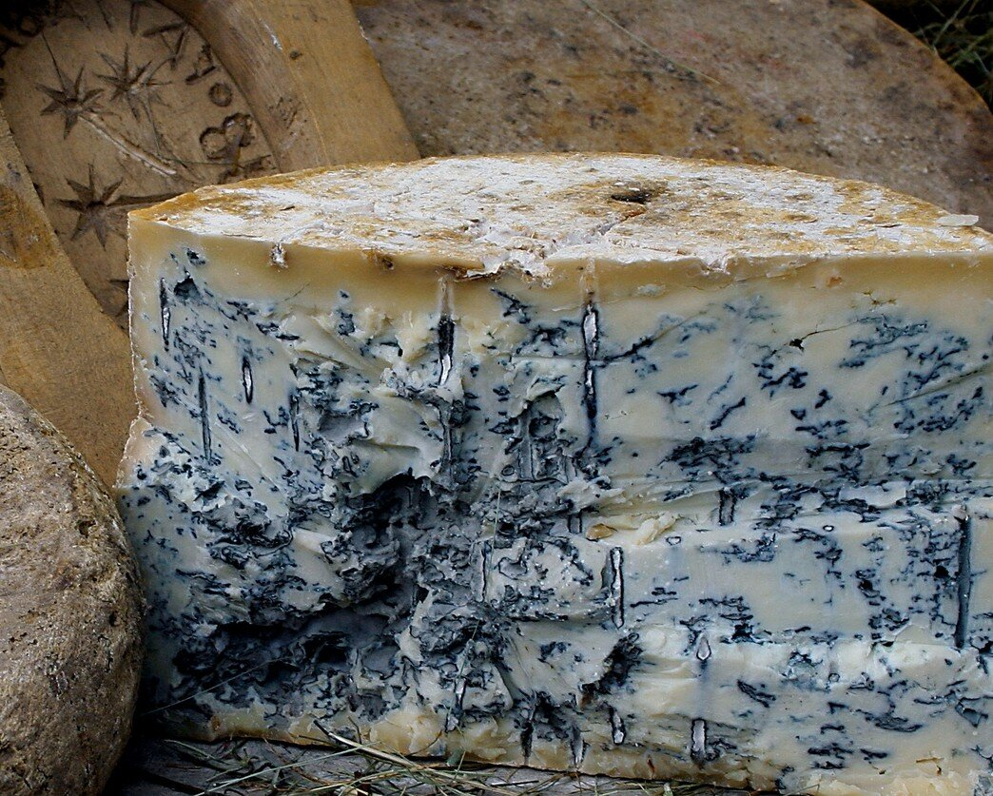
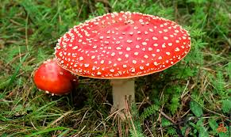
ingredients for pizza
ingredients for the dough
how to cook a pizza?

Slide 7

The pizza is ready
ingredients for pizza
ingredients for the dough

Slide 8
The pizza is ready
ingredients for pizza

